Slide 1
Personal Fitness
Chapter 5 – Your Body Composition
Chapter 6 – Maintaining a Healthy Body Weight

Slide 2
Chapter 5 Your Body Composition
Overweight
Overfat
Obese
Ideal Body Weight

Slide 3
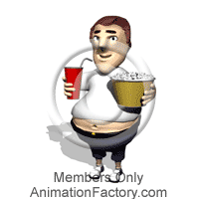
Overweight
Means weighing more than most people your age, sex and height - usually determined by a height/weight chart.
May be misleading if someone is very muscular.

Slide 4
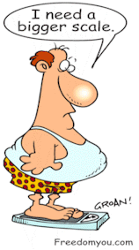
Overfat
Having more fat than you
should as determined by your
skinfold measurements.
Females = 25-30% fat is overfat
Males = 20-25% fat is overfat

Slide 5
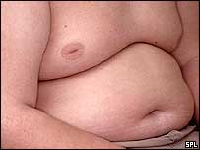
Obese
Being very overfat as determined by your skinfold measurements.
Females = greater than 30% fat
Males = greater than 25% fat

Slide 6
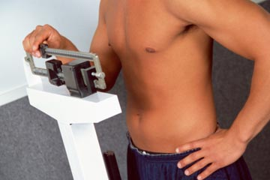
Ideal Body Weight
The best weight for a person with
body fat percentage maintained
within an acceptable range.
Females = 22% ideal body fat
Males = 15% ideal body fat

Slide 7
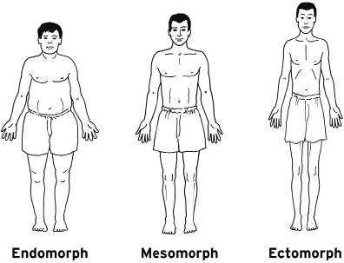
Somatotype = Body Types

Slide 8
1. Ectomorph: thin,
slender body build,
lack of muscle contour.

Slide 9
Mesomorph: athletic,
muscular body build,
bone and muscle development are important.

Slide 10
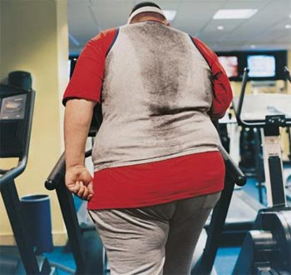
3. Endomorph: heavy,
rounded,
somewhat flabby body type,
limited muscular development.

Slide 11
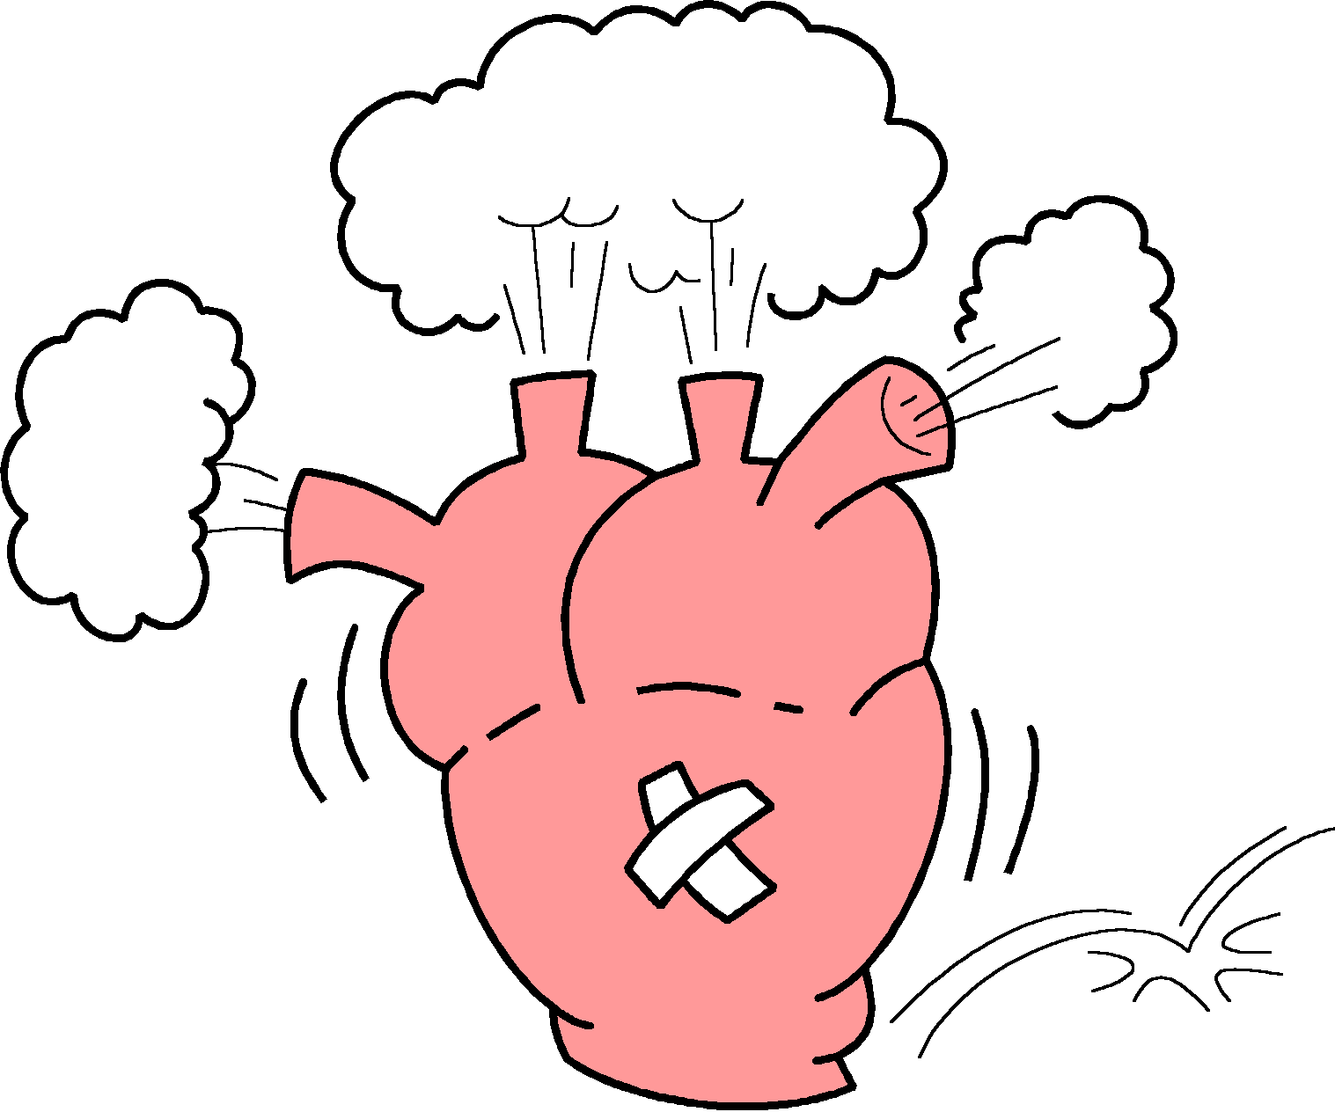
Health-related Problems for Excess Fat
High blood pressure
Increased level of cholesterol and fats in the blood
Bone and joint disorders
Diabetes
Lower back difficulties
Respiratory ailments
Greater chance of accidents

Slide 12
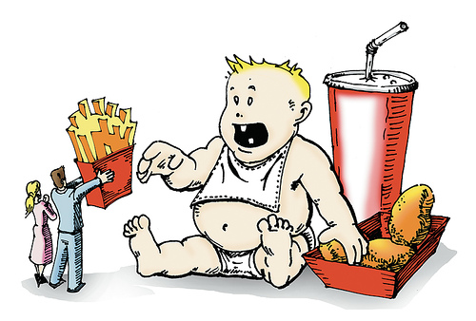
What Causes Overweight and Overfat
Heredity and environment
Childhood obesity
Inactivity
High fat diet
Medical problems
Creeping Obesity

Slide 13
Chapter 6 Maintaining a Healthy Body Weight
Exercise and Weight Control
Fad Diets
Dangers of Dieting

Slide 14
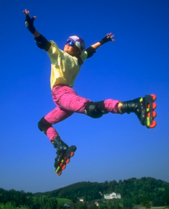
Exercise & Weight Control
Exercise...
burns calories
maintains muscle tone
improves ability to burn fat
burns stored fat if it is vigorous
improves body’s ability to burn fat
increases lean muscle tissue
helps weight tends stay off

Slide 15
Combining Diet & Exercise
A sound, nutritious diet combined with vigorous exercise is the best strategy for lifetime weight control.
• exercise develops muscle as it burns fat
• burn 250 more calories and take in 250 fewer calories than you normally do to lose a pound a week
• establish permanent eating habits that you can and will maintain throughout your life

Slide 16
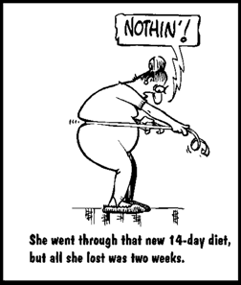
Fad Diets
One that promotes an approach to
eating that depends on one food, a
special combination of foods, or the
elimination of or our dependence on one major food group.
These diets ultimately fail because they do not bring about a change in basic eating habits. Empty Calories

Slide 17
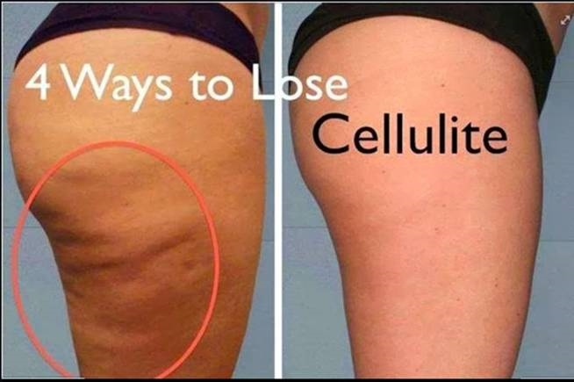
Myths about Weight Control
Spot reducing - it
cannot be done
Eliminating cellulite –
it is just fat and must
be lost just like all other
fat in the body
Special equipment –
recognize the limitations
and dangers of using these
techniques

Slide 18
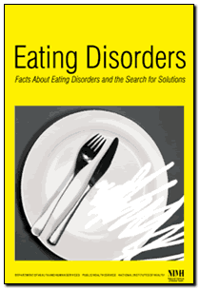
Special Dangers of Dieting
Anorexia Nervosa - a condition of self-imposed starvation in order to maintain an extremely low body weight
Bulima - a pattern of binge eating and purging (eliminating) the food by vomiting and laxatives

Slide 19
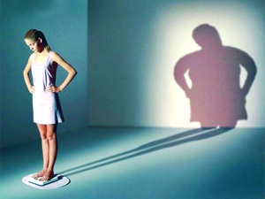
Eating Disorders
Bulimia
Binge & Purge
Anorexia
Starve yourself

Slide 20
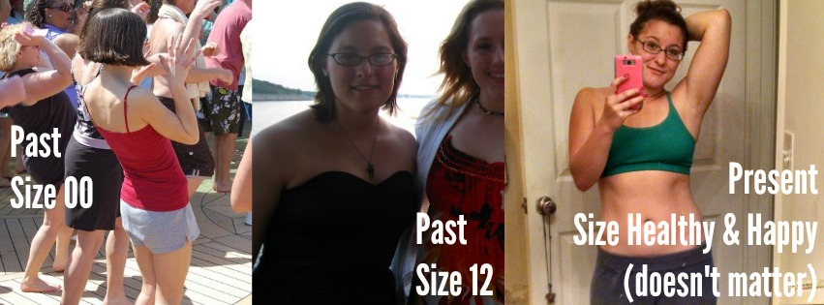
Eating Disorders

