Slide 1
Personal Fitness
Chapter 4 – Nutrition and Your Personal Fitness

Slide 2

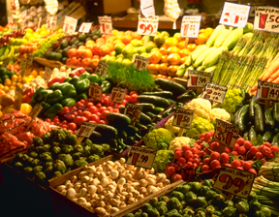
Chapter 4
Nutrition and Your Physical Fitness

Slide 3
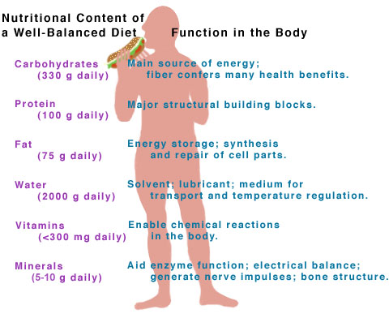

Nutrients vs. Nutrition
Nutrients: substances in food that your body needs for energy, proper growth, body maintenance, and functioning.
Nutrition: the study of food and how your body uses the substances in food.

Slide 4

Influences on your Food Choice
Hunger: natural drive to protect from starvation
Appetite: personal desire, rather than need
Culture: ethnic background influence food choice
Family & friends: foods you grow up with
Emotions: you eat because of your emotions (bored?)
Convenience & cost: busy schedule & easy to prepare
Advertising: food ads make you
have an appetite

Slide 5
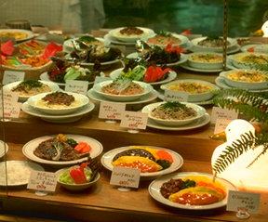
Six Essential Nutrients
1. Carbohydrates
2. Protein
3. Fats
4. Minerals
5. Vitamins
6. Water

Slide 6
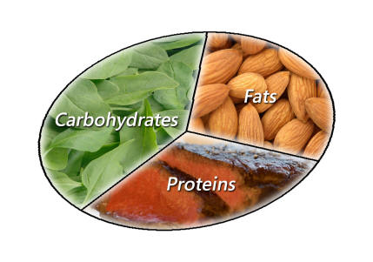
Nutrients for Energy
Carbohydrates: are the starches and sugars found in food – they are the body’s chief source of ENERGY.
Proteins: help build, maintain, and repair body tissue – they are the 2nd source of ENERGY
Fats: supply a concentrated form of energy and help transport other nutrients to locations in the body where they are needed.

Slide 7

Breaking down Carbohydrates
Simple carbohydrates: these are sugars (found in fruit, candy, cookies, and pop) – absorbed quickly into the bloodstream and provide quick form of energy.
Complex carbohydrates: these are starches (found in certain vegetables (corn/potatoes), breads, cereals, pasta, rice, and dry beans) - broken down slower in the body & supply longer lasting energy.
Dietary Fiber: a special subclass of complex carbs that has several functions, including aiding the body in digestions.
Fiber is not digestible and provides no calories.
Found in whole grain, vegetables, and fruit.

Slide 8
Breaking down Carbohydrates
If a person takes in more carbohydrates than his or her body can use immediately for energy or store as glycogen, the excess glucose is stored as ADIPOSE TISSUE – this is called body fat.
45-65% of the calories you consume daily should come from carbohydrates – mostly complex carbs

Slide 9
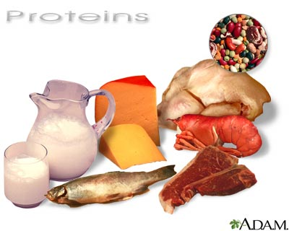
Breaking down Proteins
Your body needs protein for: growth, repair, and maintain itself.
Protein help fight diseases (immune system)
Amino Acids: the building blocks of proteins
There are 22 different amino acids, your body manufacture all but 9 – these 9 are called essential amino acids (your get them from foods).
Muscles are made up of 29% protein and 70% water

Slide 10
Breaking down Proteins
Complete proteins: contain all 9 essential amino acids.
Found in animal products (meats & dairy)
Incomplete proteins: they lack one or more of the essential amino acids.
Found in soybeans & plant foods
Vegetarians: individuals who eliminates meat, fish, and poultry from their eating plans – they consume incomplete proteins.
10-35% of the calories you consume daily should come from proteins– mostly incomplete proteins – complete proteins carry high calories & fat.

Slide 11
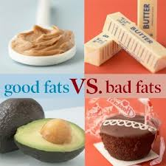
Breaking down
Fats
Types of FATS:
Saturated fats: fats that come mainly from animal, lard and butter – often solid at room temperature – BAD Fats (not healthy)
Trans fats: fats that re formed when certain oils are processed into solids – found in margarine & shortening, also found in processed foods: partially hydrogenated. BAD fats (not healthy)
Unsaturated fats: fats that come from plants and are usually liquid at room temperature – found in corn, soybean, olive, sunflower and fish oils – GOOD fats (healthy)

Slide 12
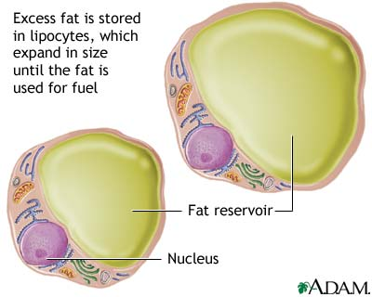

Slide 13
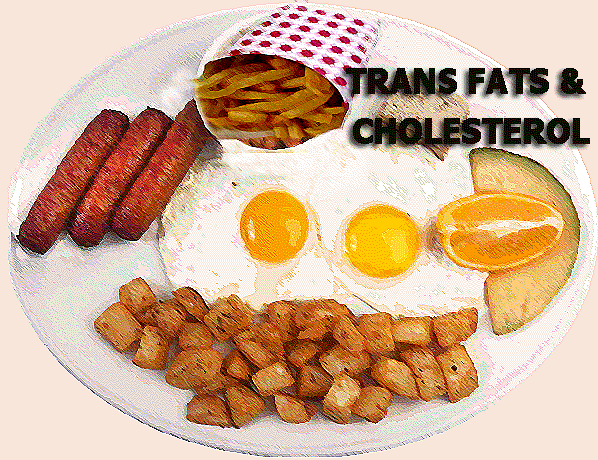
What is Cholesterol?
A fatty like substance that is produced in the liver and circulates in the blood.
Found in foods of animals (such as egg yokes, meat, & high-fat milk.
Cholesterol increases risk for heart disease
20-30% of the calories you consume daily should come from fats– mostly unsaturated fats.

Slide 14

Cholesterol in the blood
Two types of lipoprotein associated with cholesterol
Low-density lipoproteins (LDL):
- contributes to clogging of arteries by depositing the extra
cholesterol on the lining of the arteries
- BAD Cholesterol
- LDL’s are very harmful
High-density lipoproteins (HDL):
- picks up extra cholesterol and eliminates it from the body and they
are used for energy
- GOOD cholesterol
- HDL’s are beneficial

Slide 15


Slide 16

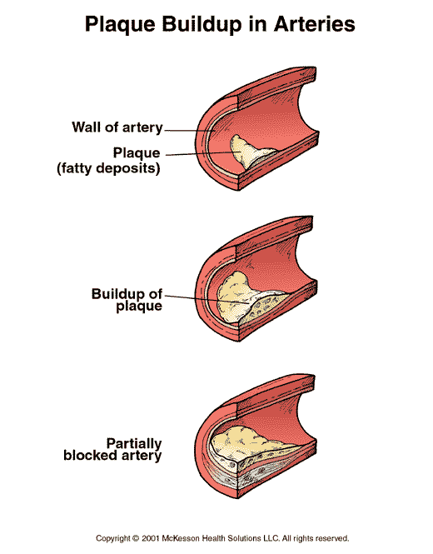
Clogged Artery due to
Cholesterol buildup

Slide 17
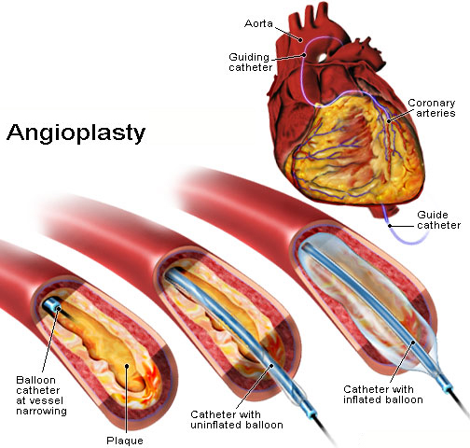

Slide 18
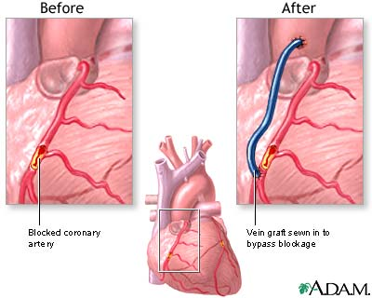

Slide 19
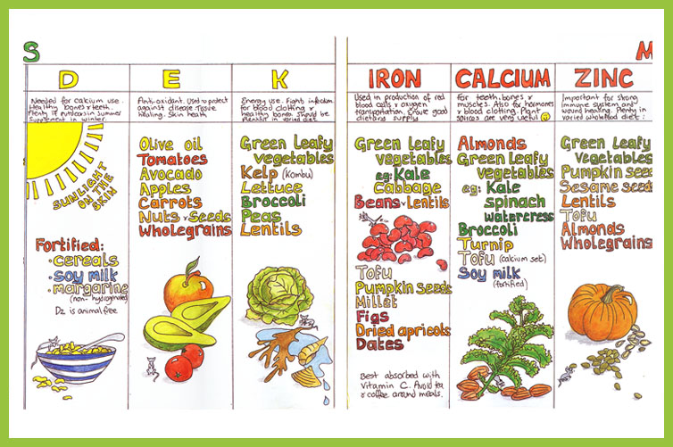
Vitamins vs. Minerals
Micronutrients – nutrients needed in tiny amounts
Vitamins: micronutrients that help control body process & help your body release energy to do work.
Minerals: micronutrients that the body cannot manufacture but that are needed for forming healthy bones and teeth and for regulating many body vital process.
Vitamins & Minerals do not contain calories or provide the body with energy.

Slide 20

Risk of Supplements
Dietary supplements are dangerous if used to enhance athletic performance:
Ephedrine: a compound that increases the rate at which the body converts calories to energy. Ephedra causes death – stimulates the heart & body temperature.
Creatine: a supplement that increases muscle size while enhancing the body’s ability to use protein. Risky for teens because developments are unknown.
Androstenedione: a chemical agent that aids the body in its production of testosterone. Increase of heart disease.

Slide 21

Water
Most important nutrient for life – without it,
death would occur in six to seven days.
60-70% of your body weight is water.
Water helps regulate body temperature, carries nutrients to cells, aids in digestion and elimination, and is important for many chemical reactions in your body
Consume a total of 64 oz. (8 cups) daily

Slide 22
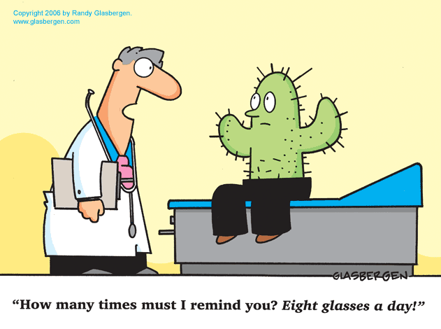

Slide 23
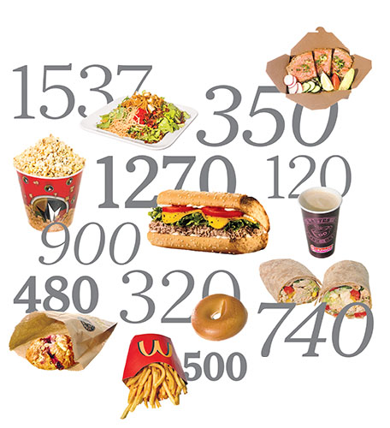
What is a Calorie?
The amount of energy needed to raise the temperature of 1 kilogram (about a qourt) of water 1 degree Celsius
It take 3,500 calories to expend (burn) 1 pound.

Slide 24
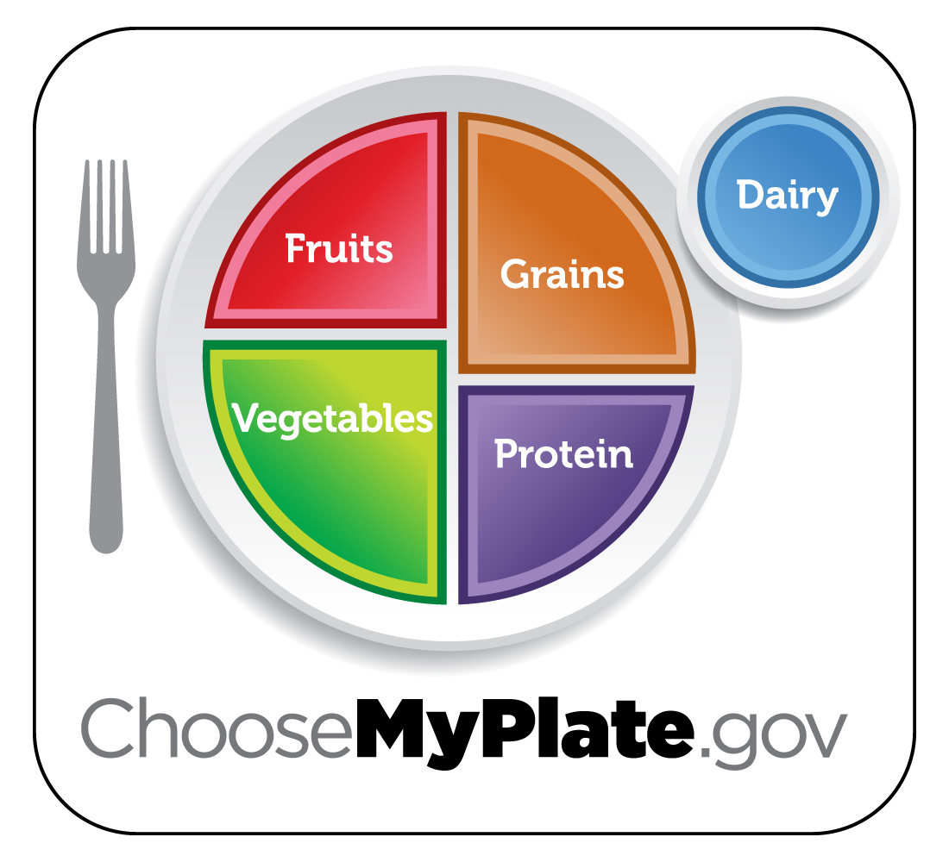
My Plate
Controlling Portion Size:
Learn to “eyeball” recognize by sight – portions that are the size see below:

Slide 25
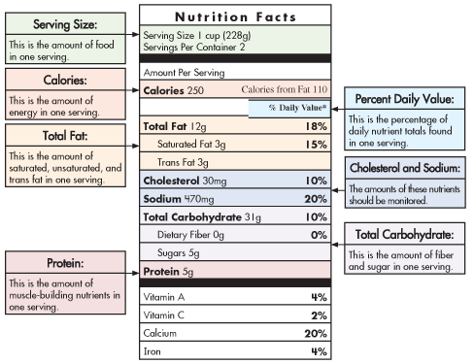
Nutrition Facts Panel
- this provides a thumbnail analysis of a food’s calories and nutrient content for one serving.
By reading the NFP:
Make wise choices
Get an idea of what and how much you are consuming
Balance your calorie intake
Pay attention of serving size – know how much your are eating.

Slide 26
Keeping Food Safe to Eat
Food borne illness: illness that results from consuming food contaminated with disease-causing organisms, the poisons they produce, or chemical contaminants.
Common types of food-illnesses:
e-coli, salmonella & Hepatitis A
Guidelines for food is to keep:
Clean: wash hands, cutting boards
Separate: raw and cooked foods; watch cross-contamination foods touching (bacteria & other pathogens)
Cook: safe heating temperature
Chill: refrigerate properly

