Slide 1
Personal Fitness

Slide 2
Personal Fitness
Chapter 1 - Benefits of exercise
Chapter 2 - Exercise Safety and Injury Prevention

Slide 3
Benefits of exercise
Chapter 1

Slide 4
Benefits of Exercise
Increased Energy
Improved Appearance
Better Muscular Strength
Help in Dealing with Stress
Improved overall Health
Improved Self Image
Improved Physical Performance
Improved Ability to Sleep
Improved Overall Daily Functioning

Slide 5
Physical Activity: any movement that works the larger muscles of the body!
Physical Fitness: the body’s ability to carry out daily tasks and still have enough energy to respond to unexpected demands.

Slide 6
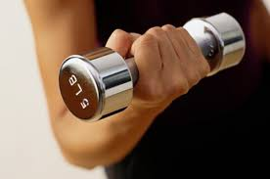
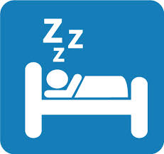
What Should I Do?
Maintain acceptable levels of fitness
Participate in regular activities
Eat nutritious foods
Sleep 8 hours a night
Have regular medical check-ups
Maintain appropriate weight
Avoid harmful substances

Slide 7
How Much Physical Activity Do I Need?
30 to 60 minutes or more of moderate intensity physical activity
Vigorous activity – high intensity
Moderate activity – medium intensity
Examples of moderate activity:
Brisk walking - Washing windows/floors
Gardening - Washing/waxing a car

Slide 8
Health Fitness Pyramid
High Level
Fitness Zone
As Often As Possible
Learn a new
Sport or hobby
2-3 Times a Week
Strength & Recreational
Endurance Activities
3-5 Times a Week
Aerobic Exercise Flexibility Exercise
Swim, cycle, jog stretch, yoga
Daily Activity
Health
Zone
Lifetime Behavior
Stay active – Keep moving, walk as much as possible

Slide 9
Live a balanced life!
Health Triangle Includes:
Physical
Mental/Emotional
Social
What does sedentary mean?
Inactive lifestyle

Slide 10
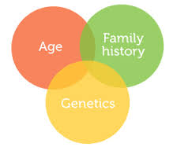
Risk Factors & Your Behavior
Risk factors you have no control over:
Age
Heredity
Gender
Risk factors you can control:
Be physically active
Practice healthy eating habits
Avoid smoking/tobacco
Manage stress in your life

Slide 11
6 steps to the behavior-change stairway
What changes your attitude about personal fitness?
Peer influence: negative attitudes
The media: TV, radio, movies, music, etc.
Not thinking about being personally fit
Thinking about being personally fit
Planning on becoming personally fit
Starting to become personally fit
Maintaining personal fitness behaviors
Relapse or stopping personal fitness behaviors

Slide 12
Safety and Injury Prevention
Chapter 2

Slide 13
Medical Screening
Medical Screening: a basic assessment of a person’s overall health.
Who should have a screening?
People with lifestyle habits
People over 40
People overweight/obese
People with a known chronic disease
Heart Disease, Diabetes, & Asthma

Slide 14
Fluid Replacement
Drink a couple of cups of water an hour or two before exercising
During exercise drink a cup of water every 15 minutes.
Drink 8 glasses of water a day to replace what you use during a 24 hour period

Slide 15
Fluid Balance
Fluid Balance: the body’s ability to balance the amounts of fluid taken in with the amounts lost through perspiration or excretion.
Dehydration: body’s fluid loss

Slide 16
Weather Related Illnesses
Heat Cramps: a sudden cramping of muscles caused by excessive loss of body fluids
Heat Exhaustion: a body condition usually caused by lack of fluids and excessive heat
Heatstroke: a serious condition resulting from prolonged exposure to high temperatures and the body’s inability to cool itself
Hypothermia: the breakdown in the body’s ability to produce heat

Slide 17
Physical Activity and the Cold
Frostbite: tissue damage from freezing.
Wind-chill factor: the combined influence of wind and temp on the body

Slide 18
Skin Cancer Detection
A = asymmetry – one half of a mole does not
match or look like the other half
B = bleeding – unevenness of the outside edges of
a mole
C = color – mole color not the same, may be shades
of red, white, tan, brown, blue or black
D = diameter – any increase in size indicates a
problem

Slide 19
Stitch in the Side
Exact cause is unknown, but there are a number of theories.
Muscle cramp theory: the muscles do not get enough oxygen & lactic acid builds up
Lactic Acid: the waste product produced during anaerobic exercise
2. A spasm in the diaphragm (muscle above the abdomen) caused by rapid breathing
3. Too much lactic acid in the diaphragm
4. Reduced blood flow to the area because of other body demands

Slide 20
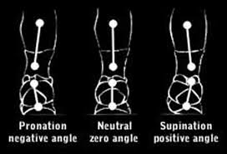
Foot Type and Foot Alignment Pronation: the heel strikes the ground then goes to the inside of the foot. Supination: the heel strikes the ground then goes to the outside of the foot.

Slide 21
Common exercise injuries
Skin injuries: cuts, scraps, bruises, and blisters
Muscle injuries: cramps
Connective tissue injuries: injuries to tendons, ligaments, or cartilage
Tendons: connect muscle to bone
Ligaments: connect bone to bone
Cartilage: tissue that surrounds the ends of the bones to prevent the bones from rubbing
Shin Splints: inflammation of tendon or muscle
Caused by: overuse, improper footwear, poor form
Stress Fractures: break in the bone caused by overuse

Slide 22
Injury Treatment (R.I.C.E.)
R = Rest the injured part
I = Ice reduces inflammation & pain
C = Compression reduces blood
flow & swelling
E = Elevation decreases internal bleeding
& swelling

